Slide 1

The Value of a Foul Ball
Anna Pierce, Will Cave, Rob White,
Matthew Reedy, and James Young

Slide 2

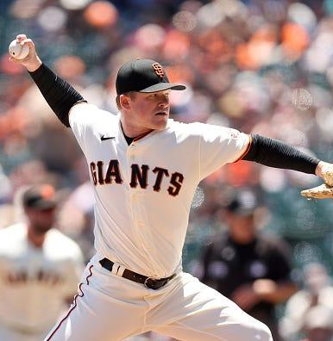
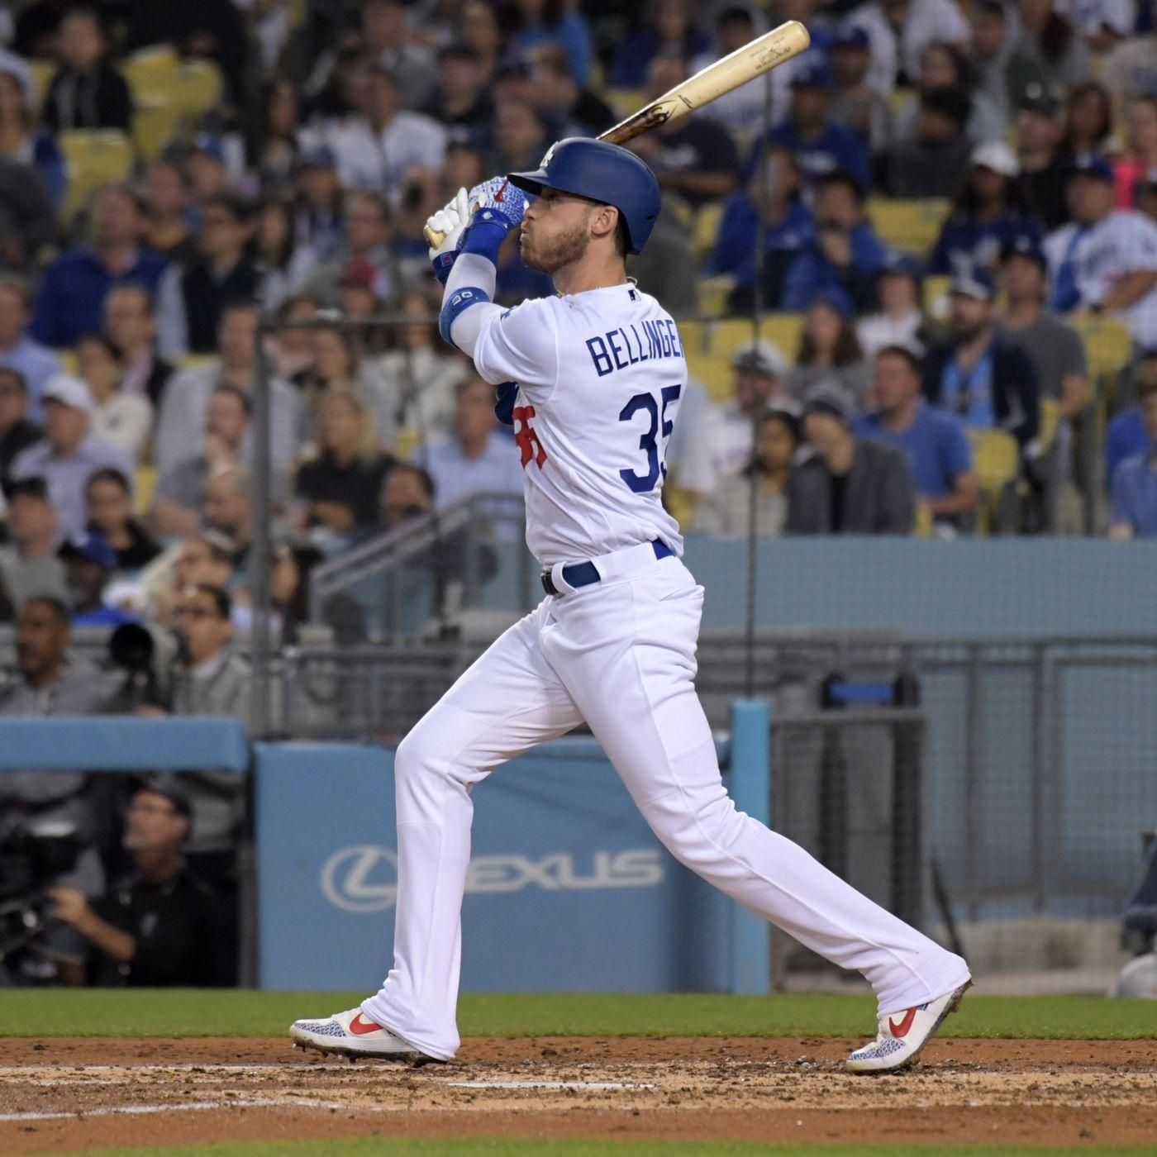
Introduction
Tasked with quantifying the value of a foul ball
Used pitch-by-pitch data from Baseball Savant and FanGraphs season level data from 2021-2023
Notes:
James

Slide 3
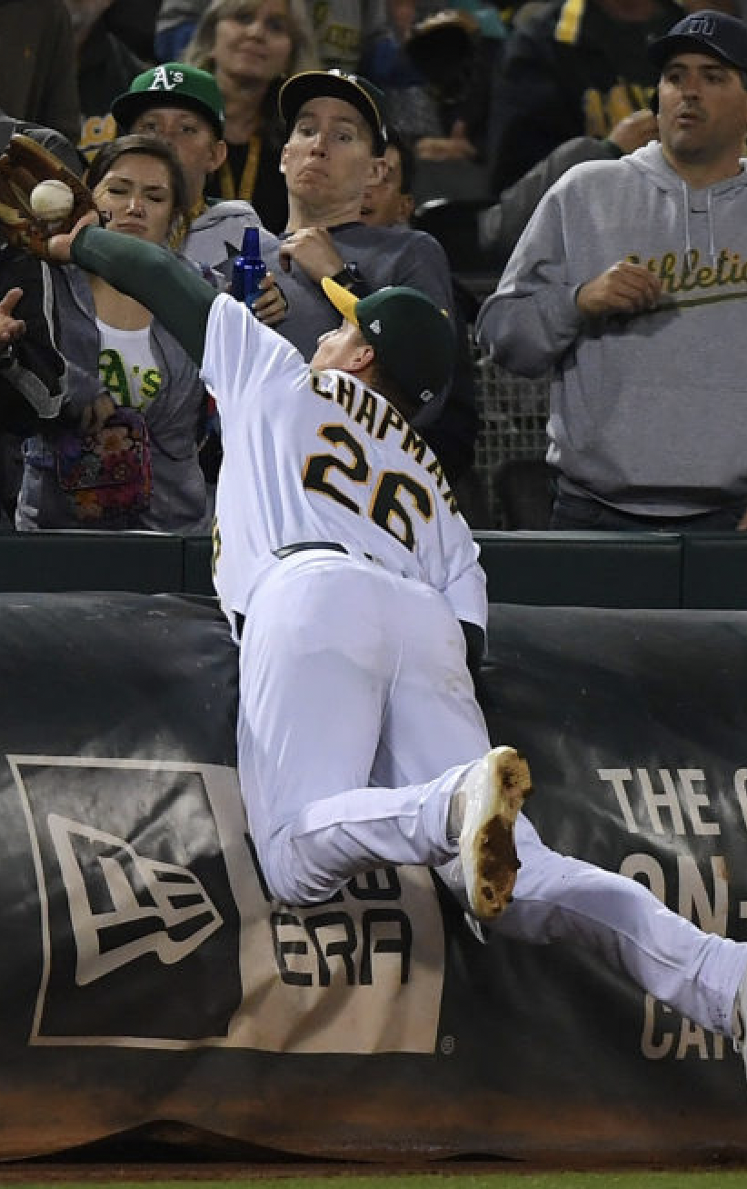
Key Assumptions
Zone variable accurately captures whether the pitch would have been a ball or a strike
Foul outs not included in final models
Notes:
James
simplify zone variable
foul outs not included because they end AB

Slide 4
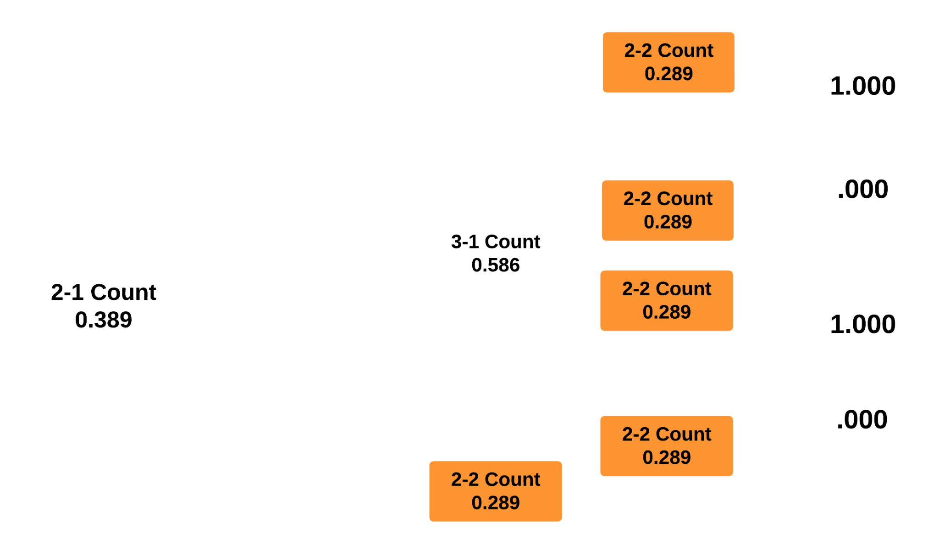
Game Situation: Flowchart
Notes:
James

Slide 5
Methodology
Create a model to quantify dynamic on-base probability for each pitch
(Pitch 1 & All Other Pitches)
Ranger-based Random Forest model to determine variable importance in predicted on-base probability change
Derive coefficients based on model results to create the formula for a singular metric
Notes:
Anna
xgboost <- ob probability given game state
rf -> change in our calculated on base probability after a foul ball prob; which variables impacted change in obp the most

Slide 6
First Pitch On Base Probability
Determining characteristics differ between the first pitch and the rest of the at-bat.
Lack of Previous Pitch Data, etc.
Built out a new XGBoost Model to Predict Batter’s On-Base Probability, for the first pitch of their at-bat.
First Pitch Model Considered Only:
Batter OBP
Average Pitcher Stuff
Average Pitcher Location
Returned an Average On-Base Probability of 0.312
Notes:
Anna

Slide 7
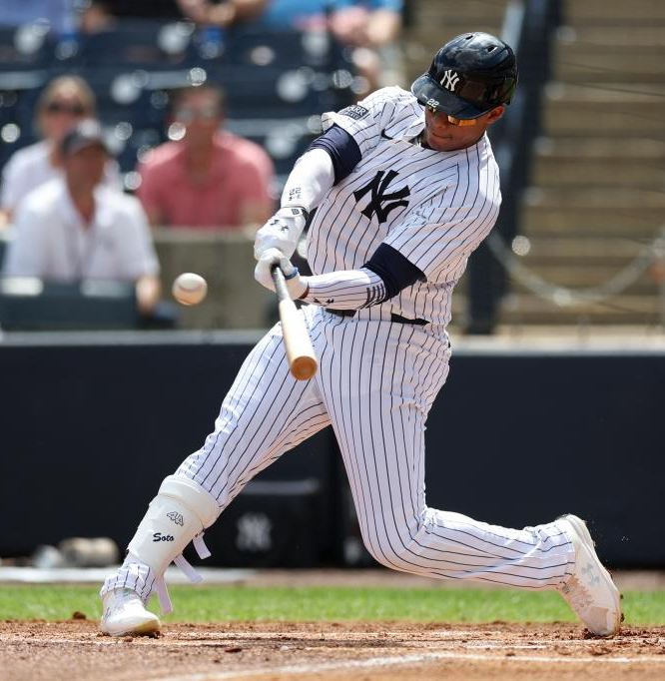
Modeling On-Base Probability
Considered the current state of the at-bat
Previous pitch metrics
Horizontal and vertical location
Miss distance
Stuff+ and Location+
Batter’s hot zone
Pitch type and pitch result
OBP as a measure of batter quality
Notes:
Will

Slide 8
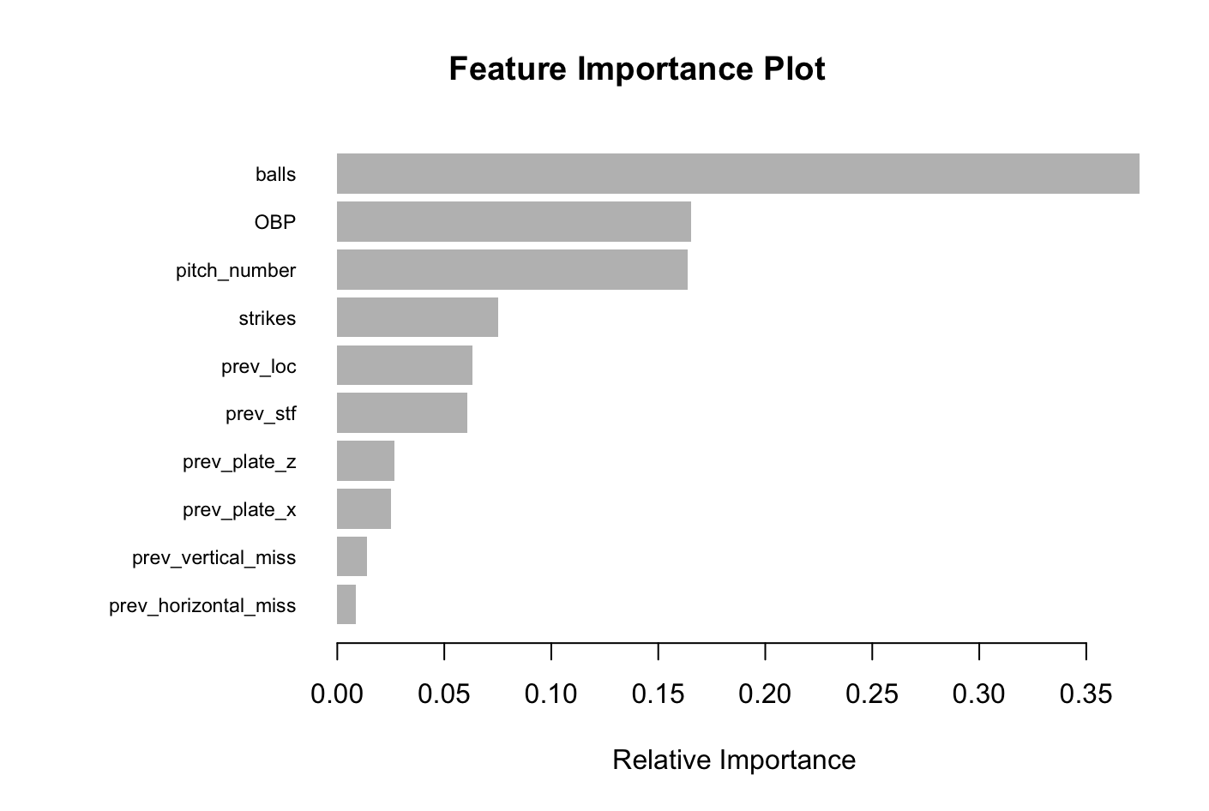
Modeling On-Base Probability
As expected, overall game state metrics were most important
Other previous pitch metrics like Stuff+, Location+, and general pitch location were also important
Notes:
Will
top 10 in variable importance, not all variables

Slide 9
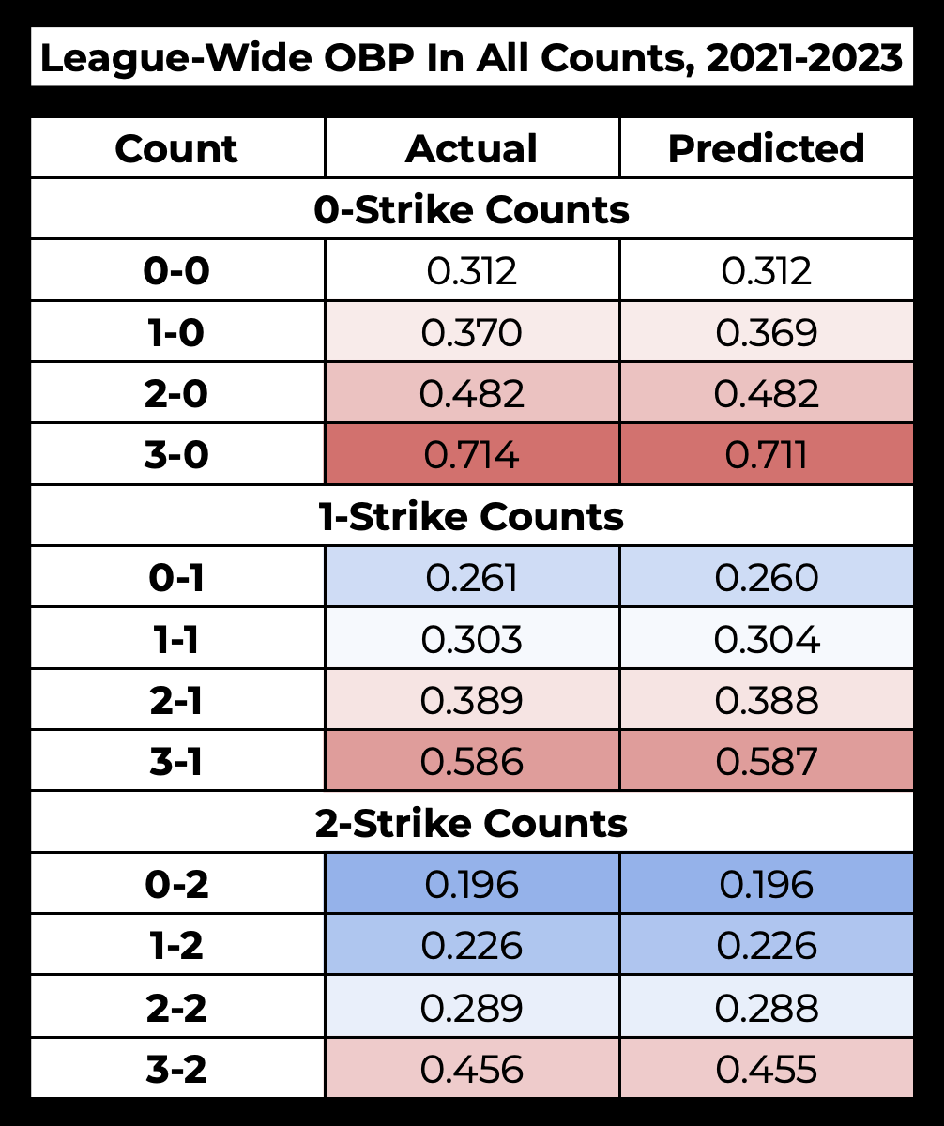
Modeling
On-Base Probability
Model returns similar on-base probabilities in each counts compared to actual situations
Slight underestimation of on-base probability in 3-0 counts
Notes:
Will

Slide 10
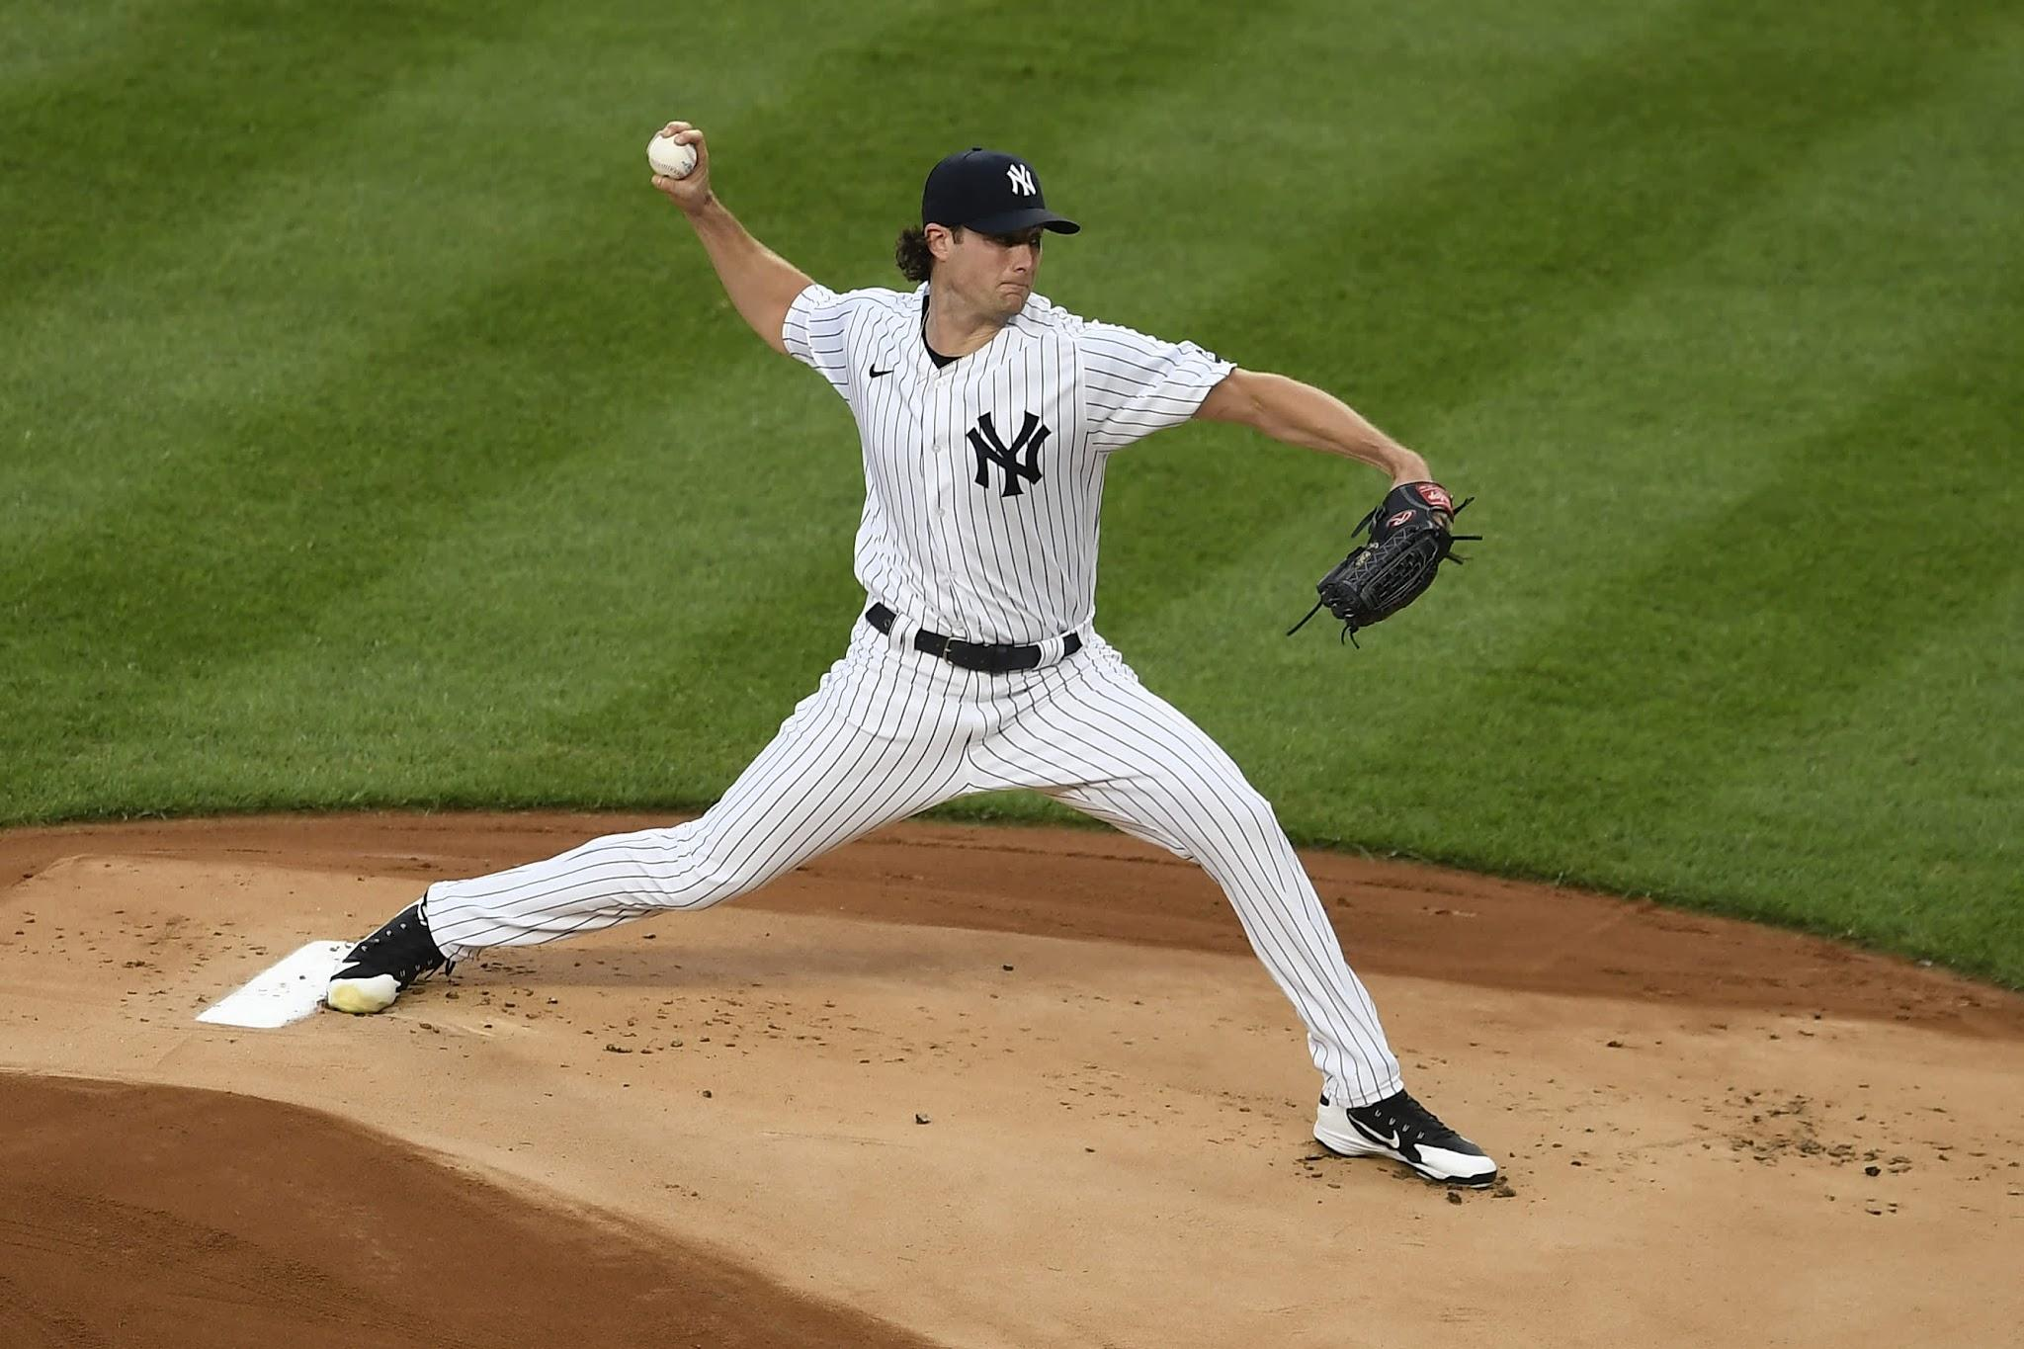
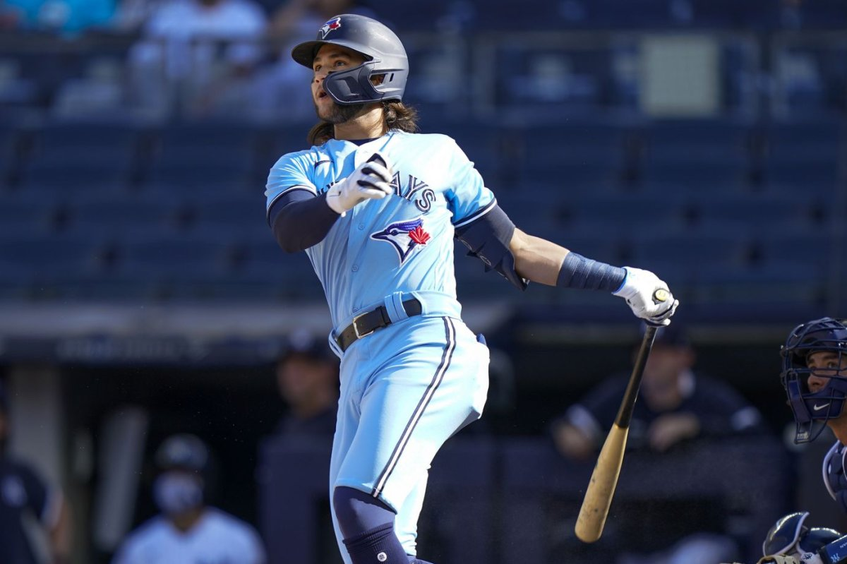
Model Application
Bo Bichette vs Gerrit Cole was one of the most common batter-pitcher matchups from 2021 - 2023
Looked at two similar at-bats and how on-base probability changed from pitch-to-pitch
Notes:
Matt

Slide 11
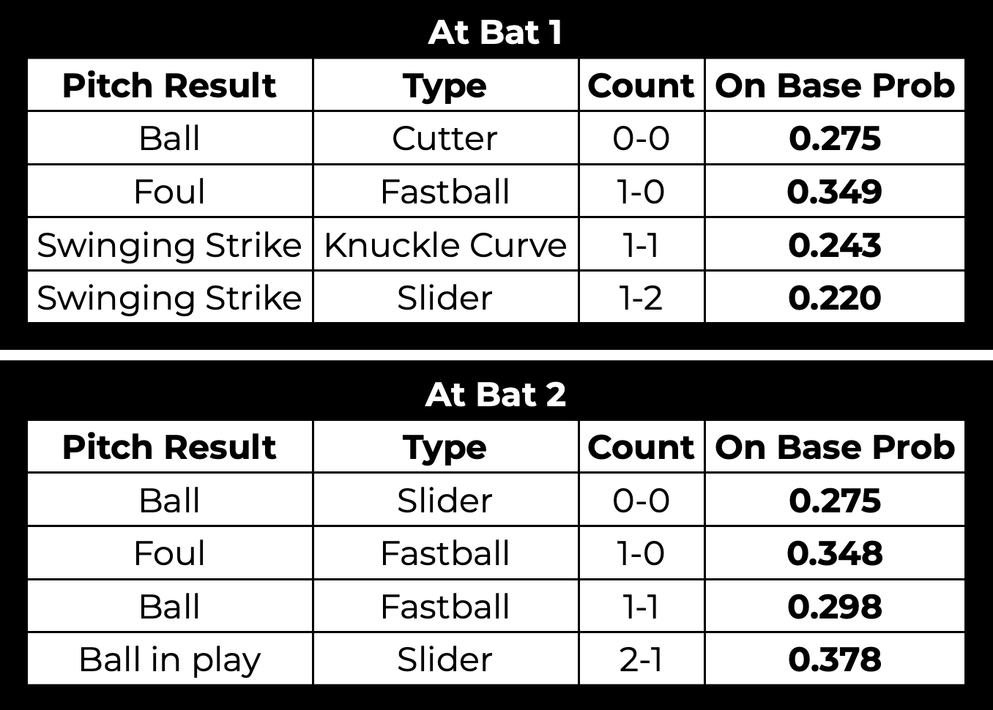
2023 Matchup:
Bo Bichette vs Gerrit Cole
Why is the decline in on-base probability significantly sharper after the foul ball in at bat 1 compared to at bat 2?
Notes:
Matt

Slide 12
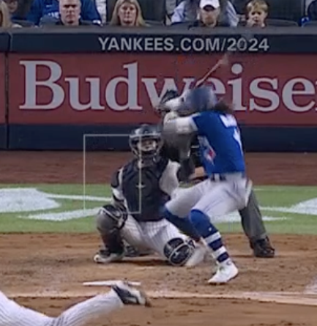
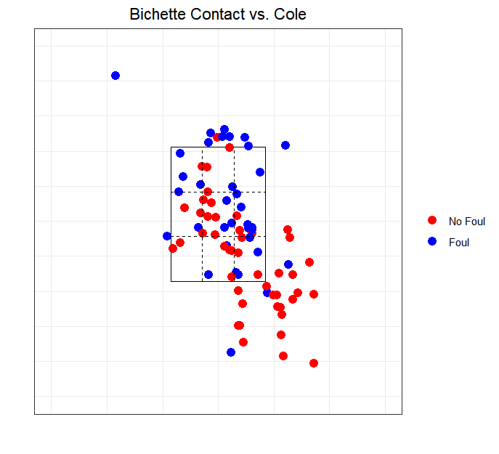
2023 Matchup:
Bo Bichette vs Gerrit Cole
Notes:
Matt
mention Cole got a strike on a pitch way out of the zone
lucky break for Cole

Slide 13
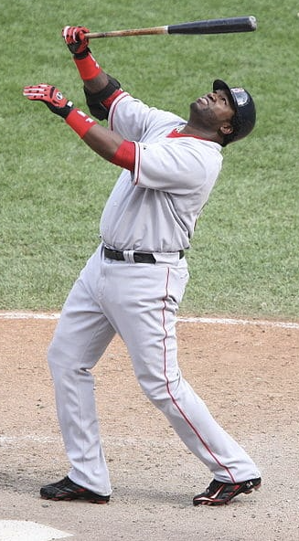
Our Metric:
Foul Reach Rate (FRR)
Ranges from -100 to 100
Based on change in on-base probability
Create an easily palatable metric
Notes:
Rob

Slide 14
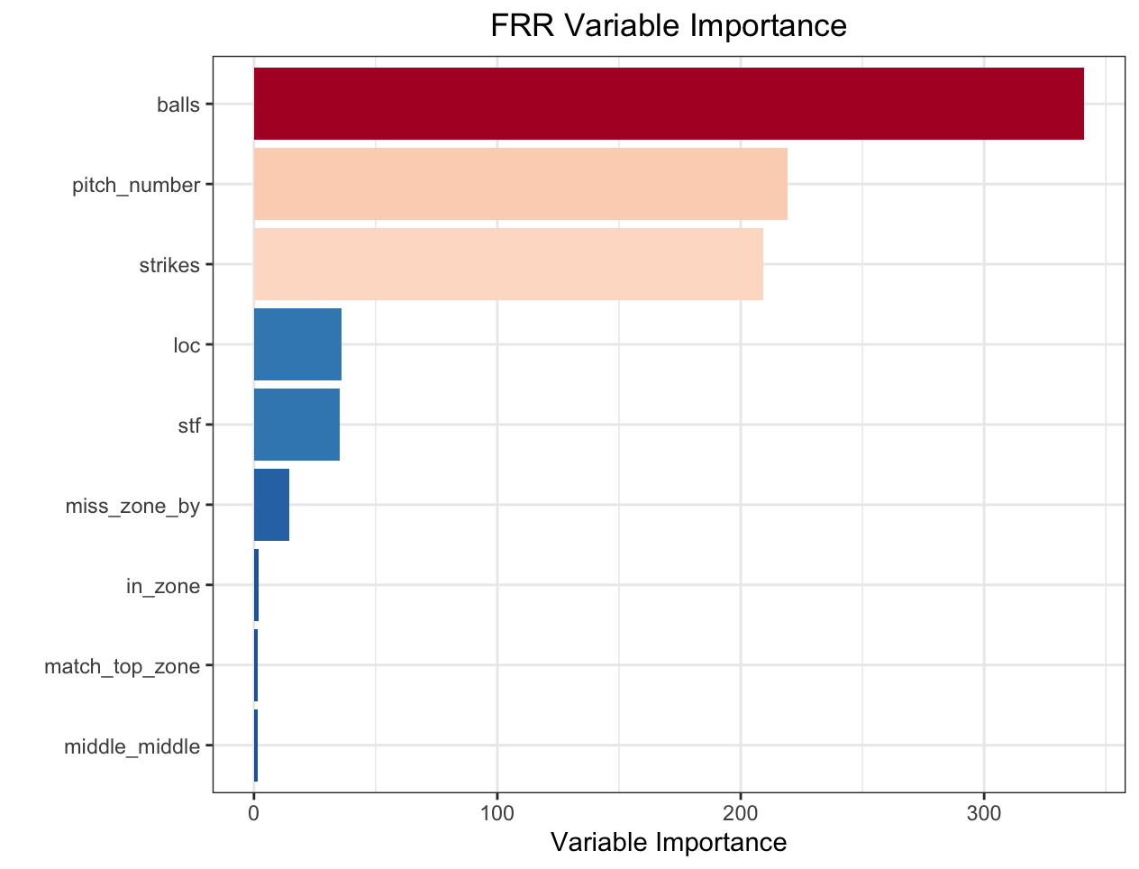
Foul Reach Rate
Created a random forest model to analyze the importance of chosen variables
Tuned for accuracy via grid search optimization
Notes:
Rob
random forest is predicting the CHANGE in our calculated on base probabilities after a foul ball
after identifying and analyzing the characteristics of the change in on base percentage for all pitches, we created a random forest model for our nine identified variables (balls, strikes, pitch number, loc, stf, miss zone by, in zone, top zone, middle middle, hot zone)
this model focused primarily on variable importance to facilitate the creation of our equation for foul reach rate -> magnitude of coefficients
go over relative importance of each quickly

Slide 15
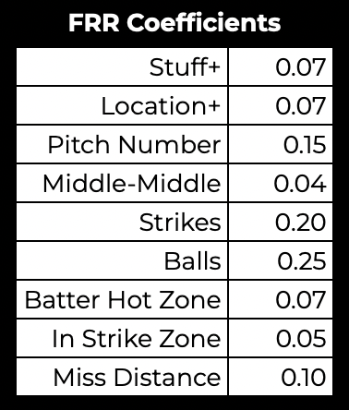
Foul Reach Rate
Coefficients established based on variable importance
Optimized by testing different sets and using the set that performed the best
Evaluated performance based on accuracy
Binary variables were 100 or -100, non-binary were scaled so lowest OBP change was -100, highest was 100
Notes:
Rob-
ADD AN EXAMPLE TO EXPLAIN HOW THE MULTIPLICATION WORKS
assign -100 to anything out of the zone
non-binary, fouling 3rd pitch of the AB leads to on average lowest change in OB probability so it is assigned -100
everything scaled based oh magnitude of change in on base probility
one for binary one for nonbinary
hammer down that we aren’t multiplying the hard metric by the coefficient

Slide 16
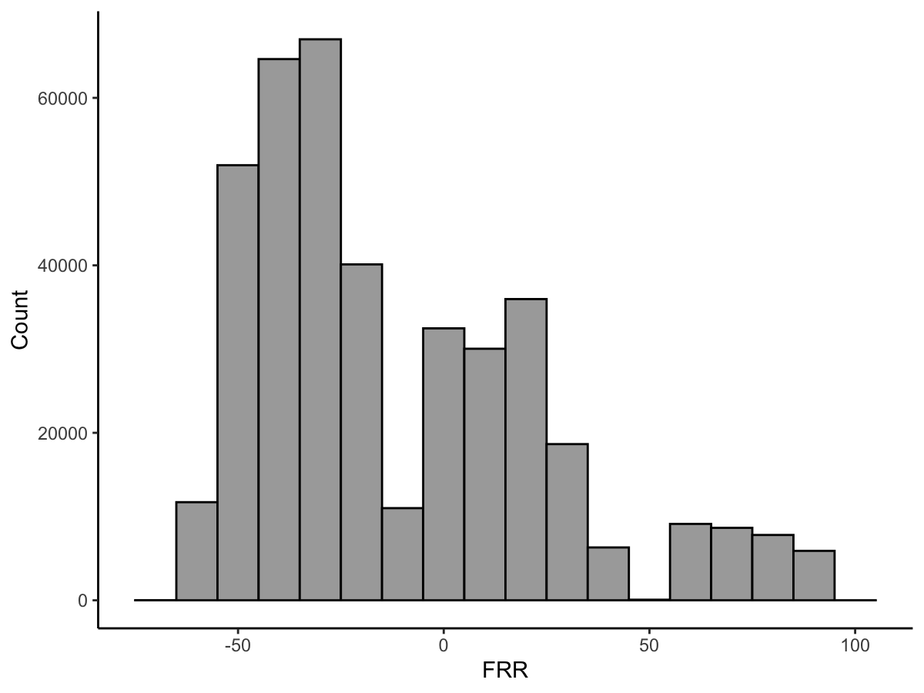
Distribution of FRR Values
Majority of foul balls classified as negative for the hitter
Hitters have more frequent outlier outcomes
Notes:
Rob

Slide 17
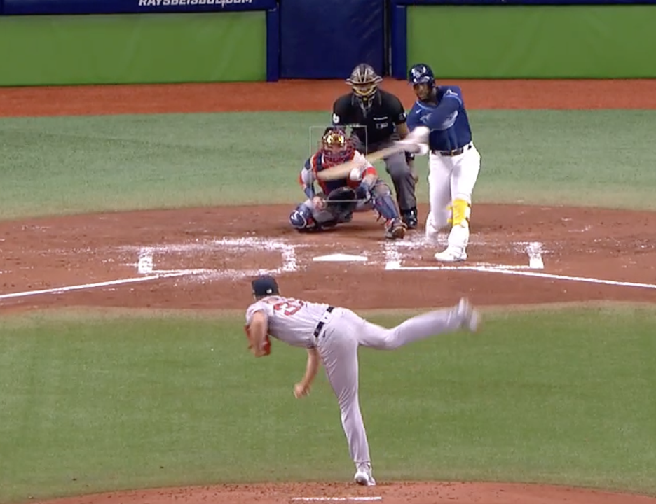
Example of Positive Foul Ball
FRR: 95
Yandy Diaz fouls off a Nick Pivetta curveball in a 3-2 count
Pivetta’s curve was his highest rated pitch in 2021
Pitch is out of his hot zone, but is a strike → best case is to live to see another pitch
Notes:
Will

Slide 18
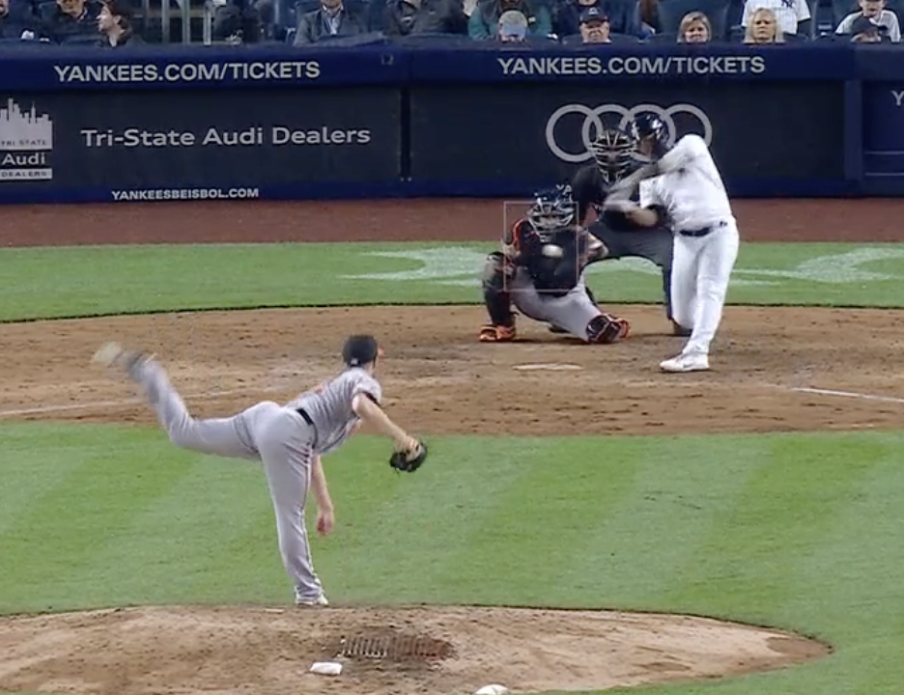
Example of Negative Foul Ball
FRR: -64
Gleyber Torres fouls off a Paul Fry changeup in a 1-0 count
One of Fry’s lowest graded pitches in 2022
Middle-middle, in hot zone
Pitch being in the zone slightly improves the grade
Notes:
Will

Slide 19
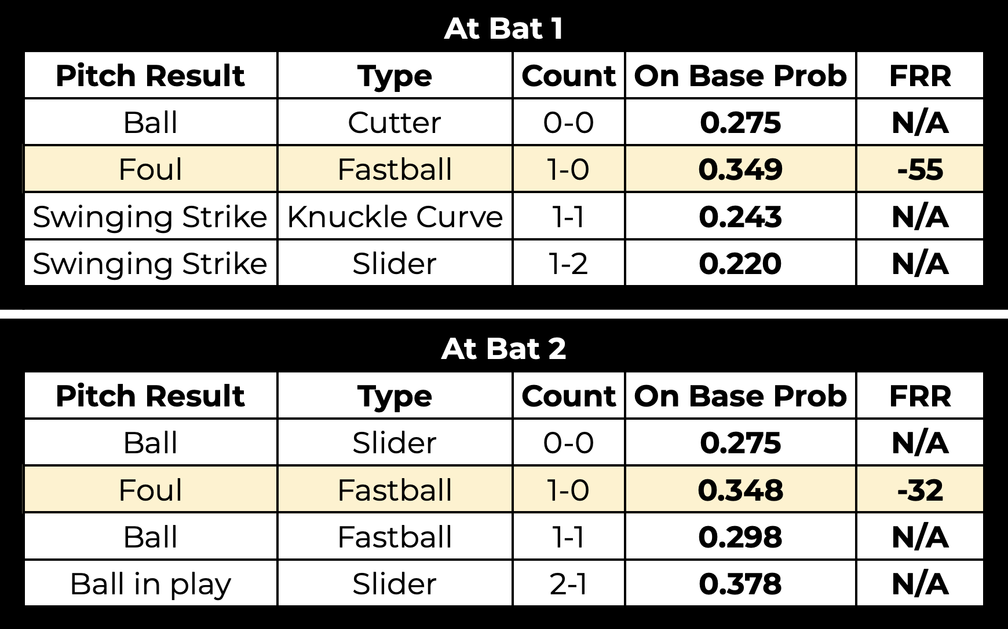
Revisiting Bichette-Cole Matchup
FRR metric is effective in capturing the difference between these foul balls
Despite leading to the same outcome, one is demonstrably better than the other
Notes:
Matt
rewards outcome not process

Slide 20
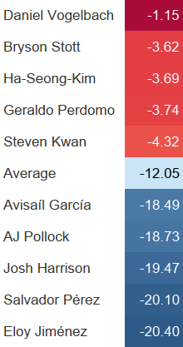
Leaders
Highest graded batters extend at bats
High contact
Lowest graded batters swing more
High chase
Notes:
Anna
top guys more likely to put hot zone pitches in play
all 3 years, 500 min.

Slide 21
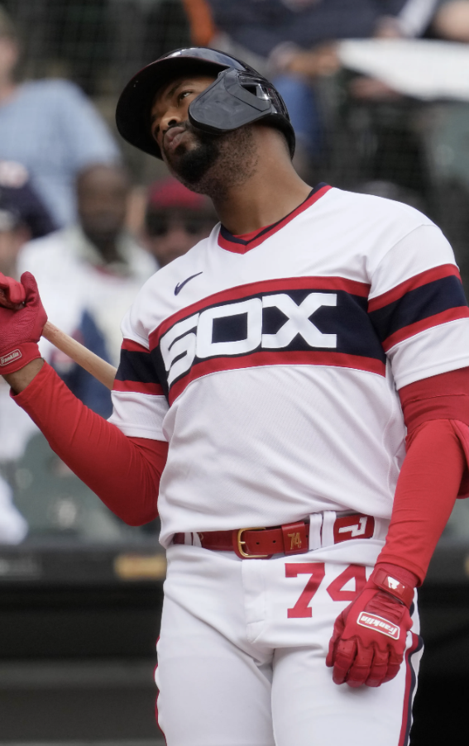
Future Improvements
Adjust on-base probability model to handle small sample sizes
Consolidate location-based variables into one variable
Treat count as a separate variable instead of ball/strike
Consider swing timing
Notes:
Rob
predictions are more standard for hitters and batters with established sample sizes -> handle outliers
as it currently stands, hard to get -100 based on our current variables -> location variables usually aren’t going to be all bad (out of hot zone, but is strike)
counts as an all-encompassing variables

Slide 22
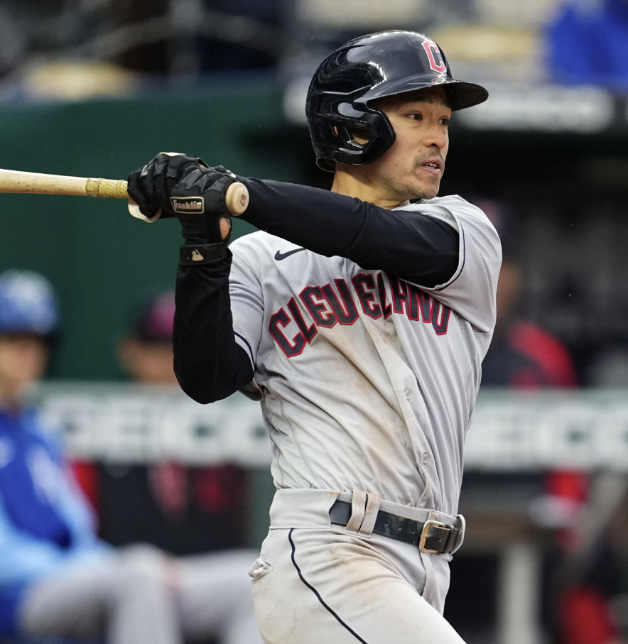
Conclusion
Found that most foul balls negatively affect the batter
Not all foul balls are equal
Fouls with 2 strikes benefit the hitter more
Early count fouls benefit pitcher
Hitters punished for swinging at balls and missing pitches in wheelhouse
FRR effectively captures these trends
Notes:
Anna
potential tweaks but overall effectively captures

Slide 23
Questions?

